Slide 1
INFINITY
Proudly Presents

Slide 2
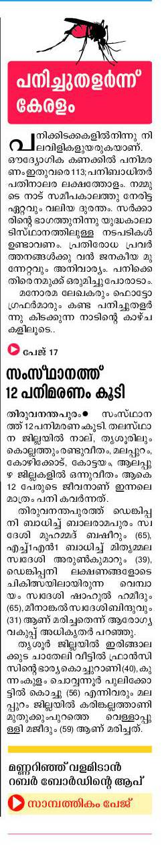
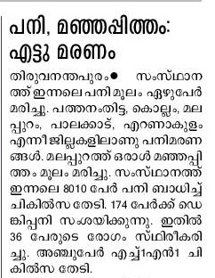

Slide 3
MEDICETAMOL

Slide 4
The Modern Day Medical App

Slide 5
FEATURES
Simple and Easy to use
Secured User Login
Hospital Tracker
Complaint Reporter
Making Appointments
Remainders for appointments

Slide 6
Anytime Anywhere Login
User and Admin Login

Slide 7
Easy to use and Easy to access Interface

Slide 8
HOSPITAL TRACKER
Locate any hospital in your nearby vicinity within a radius of 10km from your current location.
Fast and easy hospital locater
Get review, ratings, emergency contact numbers.

Slide 9
COMPLAINT REPORTER
Can easily report medical negligence to the district medical officer.

Slide 10
Appointments
Can easily fix appointments with doctors
Hospitals can add the availability of the doctors
The appointment reminder can be used to remind about the appointments
Stay healthy & worry free !!!
Be organized : Easily view & manage your appointments with doctors.

Slide 11
‘He who has health, has hope; and he who has hope, has everything.’

Slide 12
THANK YOU

